Slide 1
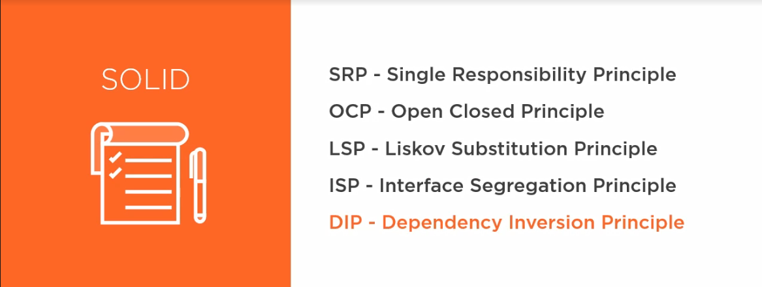
The SOLID Principles

Slide 2
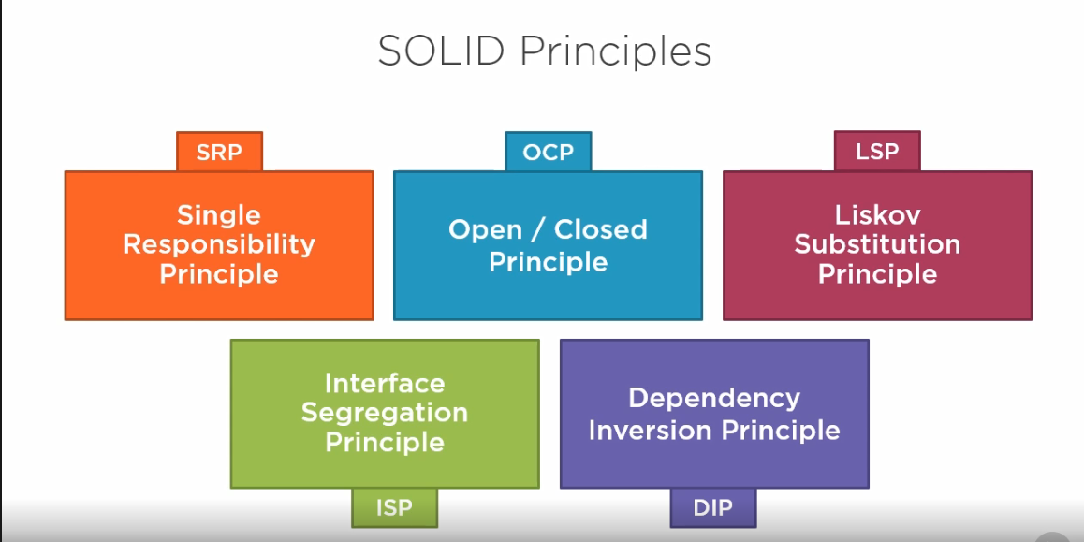

Slide 3
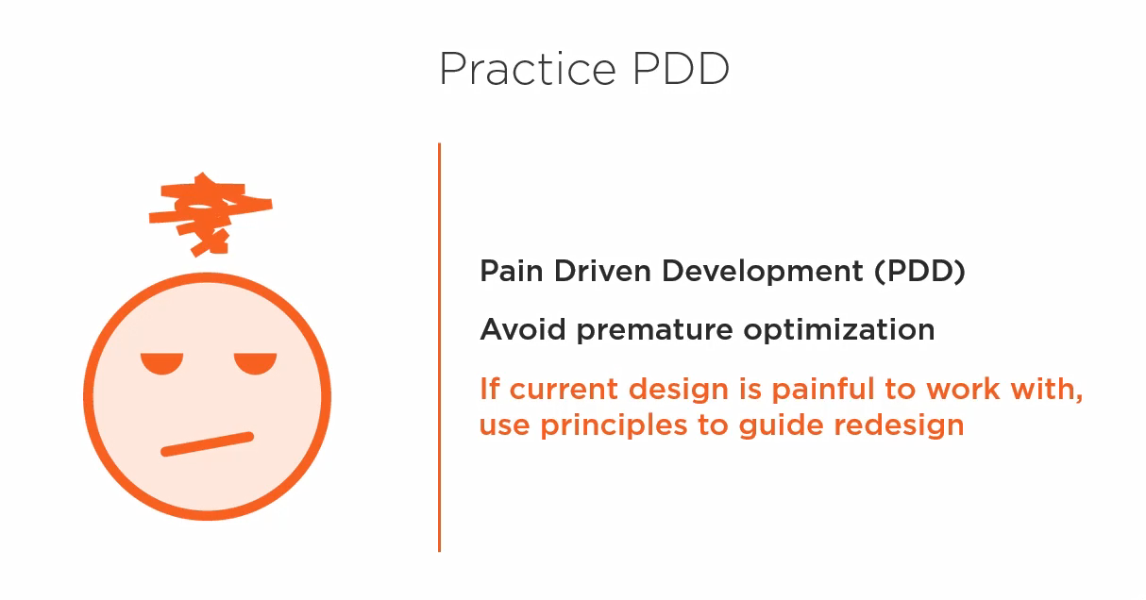

Slide 4
Single Responsibility Principle
Each software module should have one and only one reason to change.
The individual classes and methods in our applications define what the application dose, and how it does it.
Which means , every module or class should have responsibility over a single part of the functionality provided by the software and the responsibility should be entirely encapsulated by the class.

Slide 5
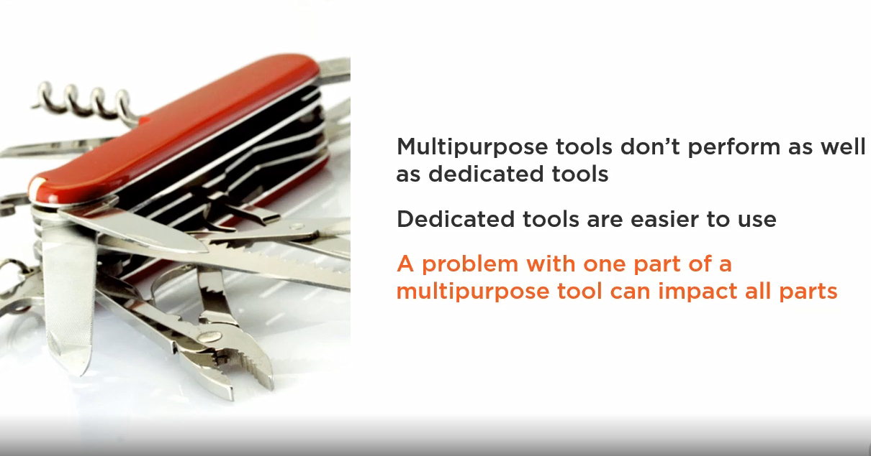

Slide 6
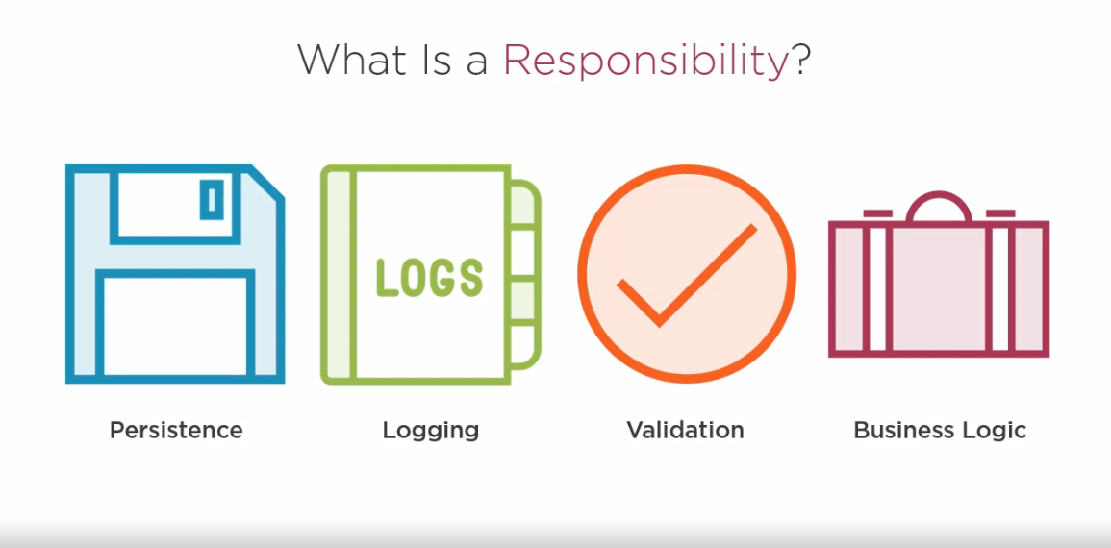

Slide 7
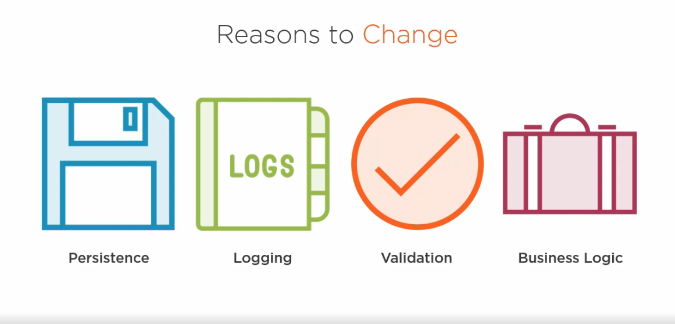

Slide 8
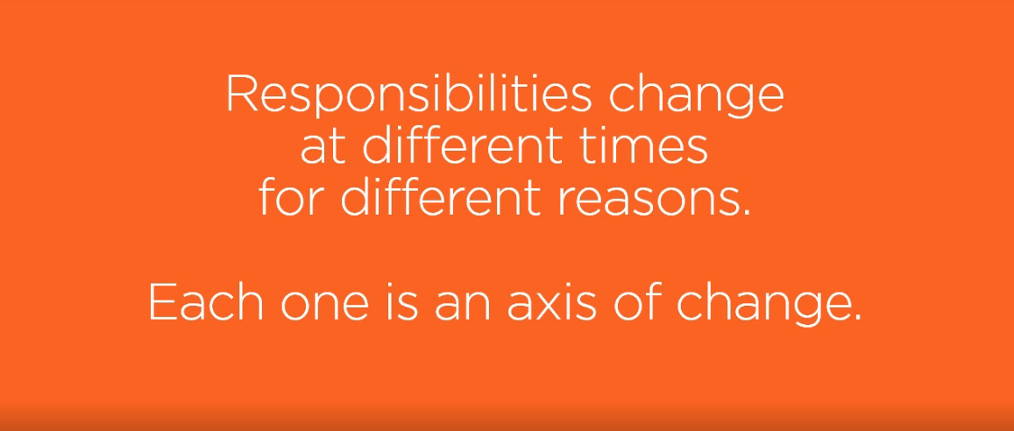

Slide 9
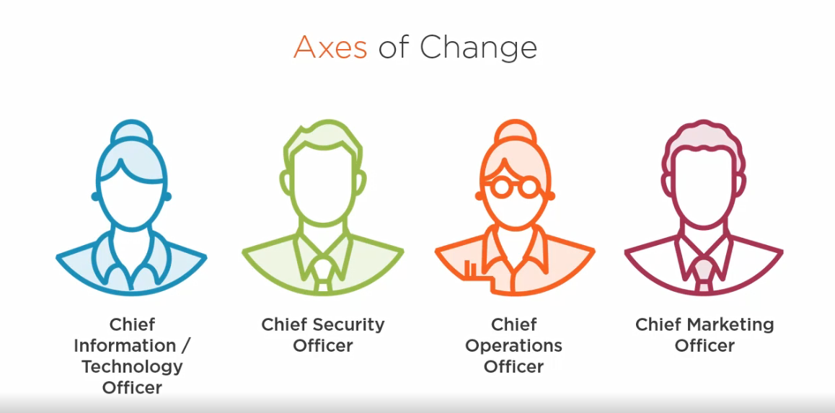

Slide 10
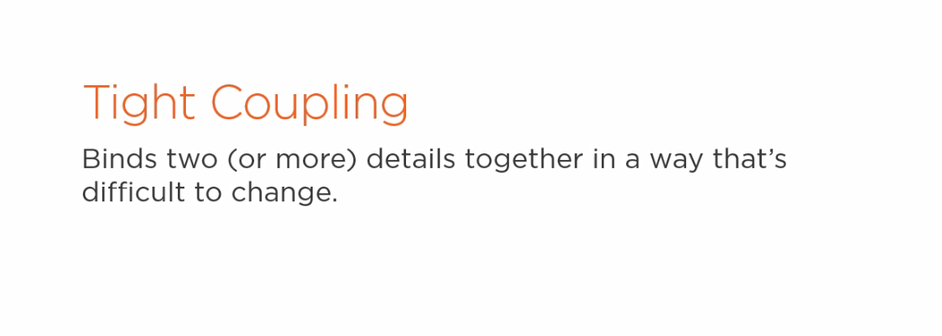
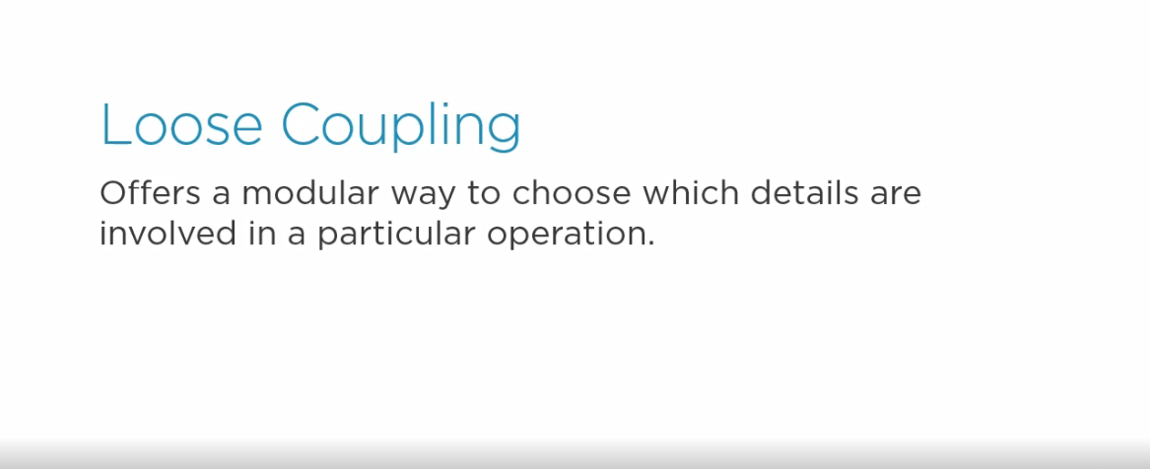

Slide 11
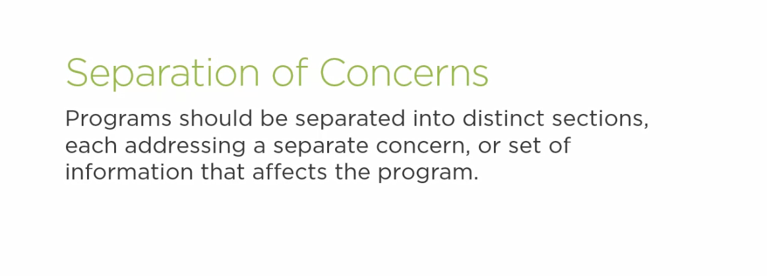

Slide 12
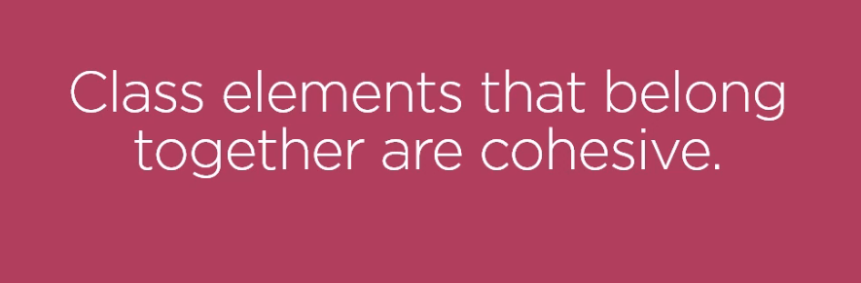

Slide 13
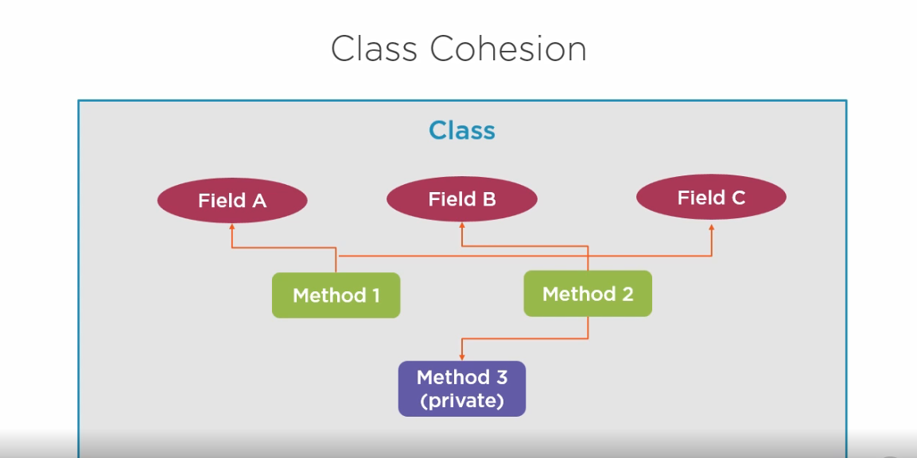

Slide 14
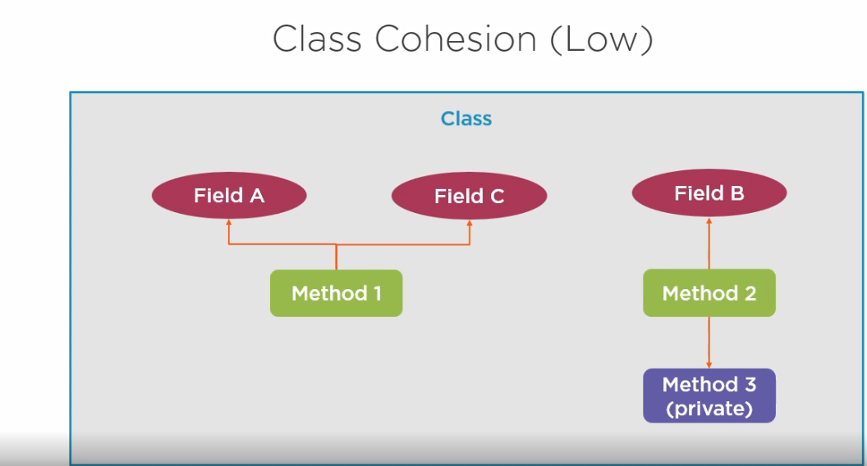

Slide 15
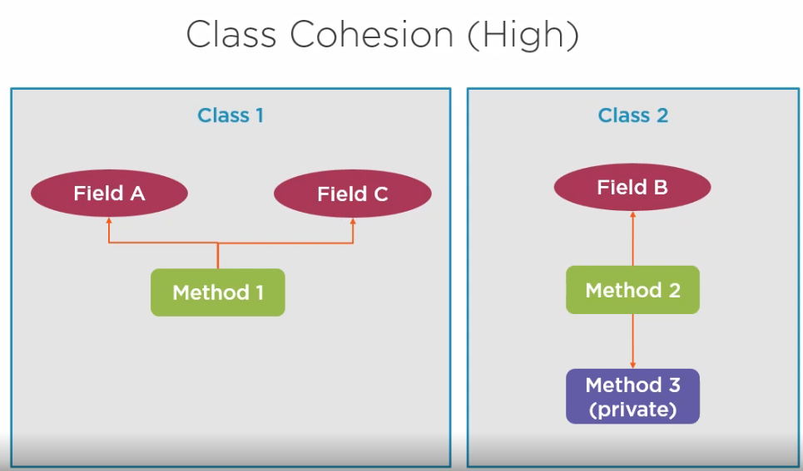

Slide 16
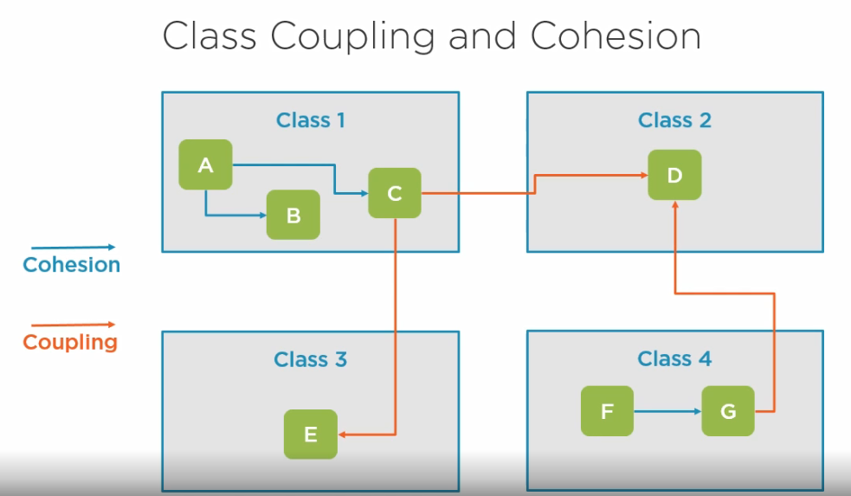

Slide 17
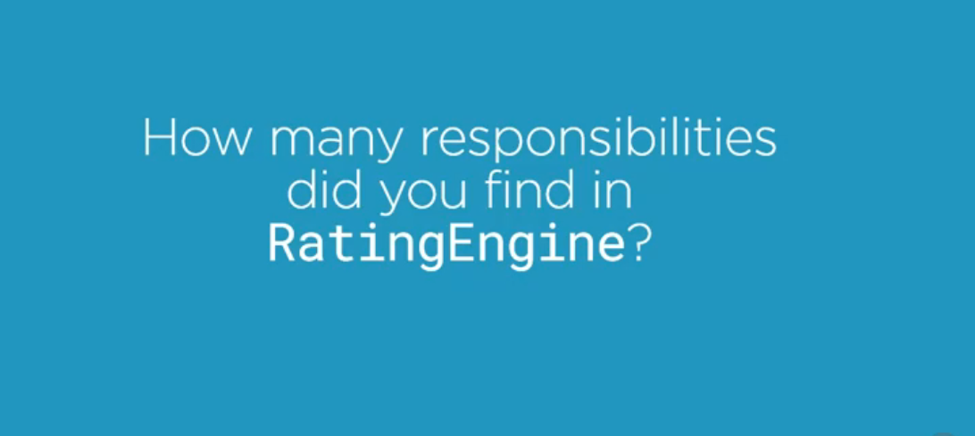
DEMO

Slide 18
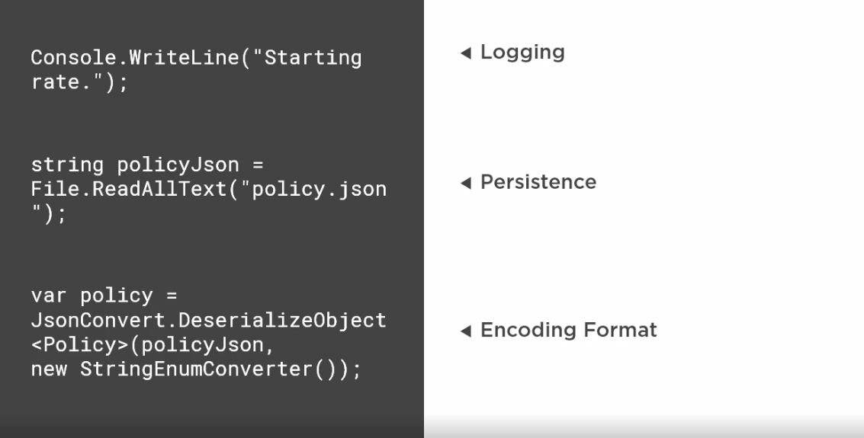

Slide 19
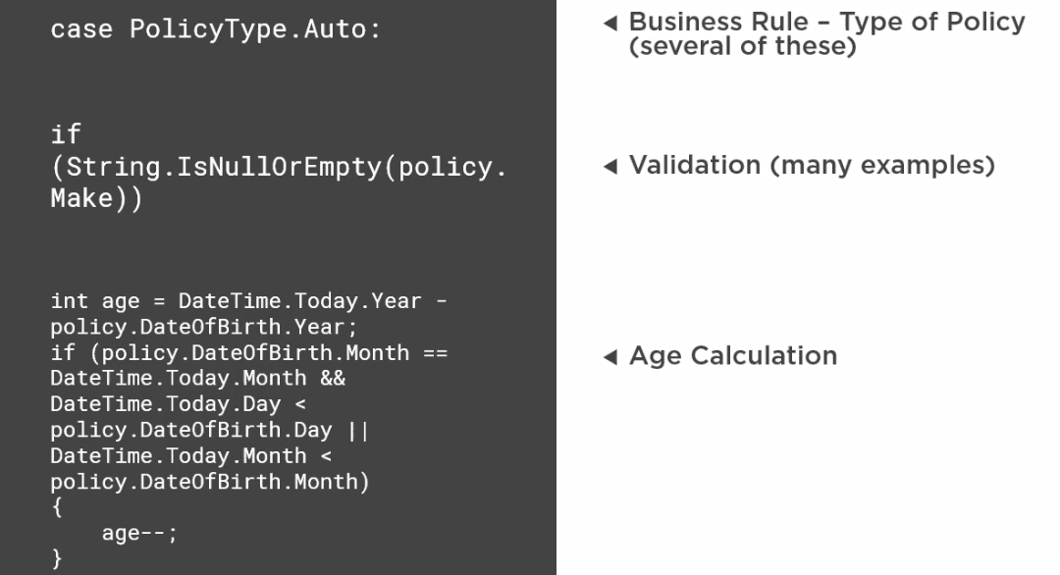

Slide 20
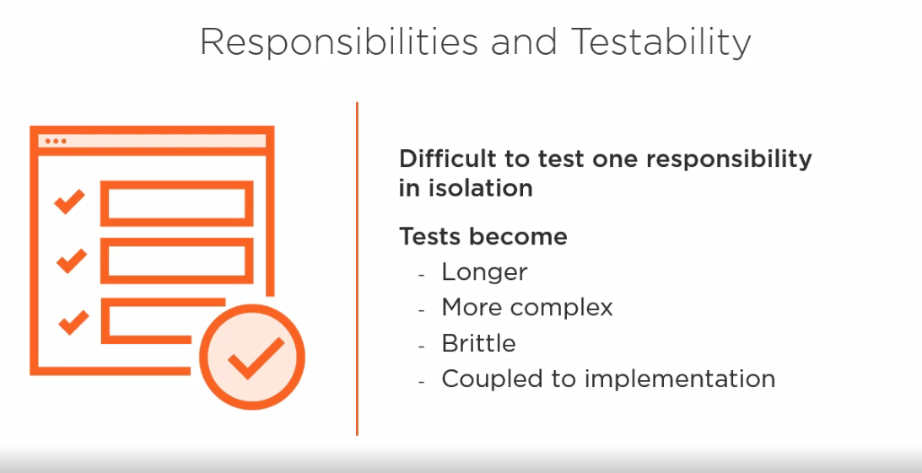

Slide 21


Slide 22
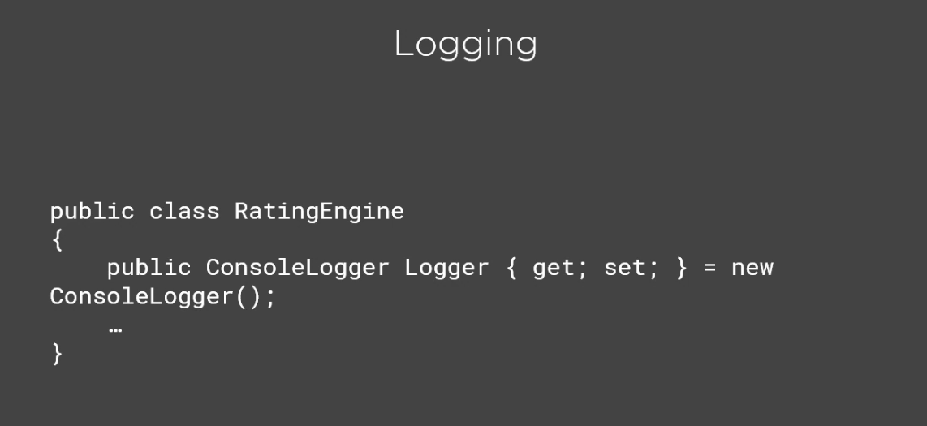
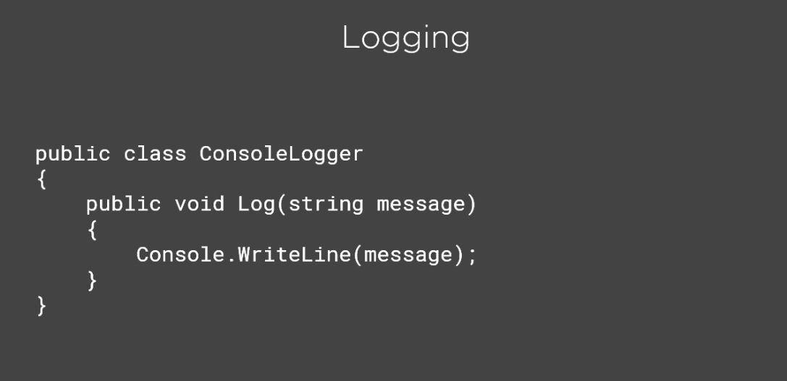

Slide 23
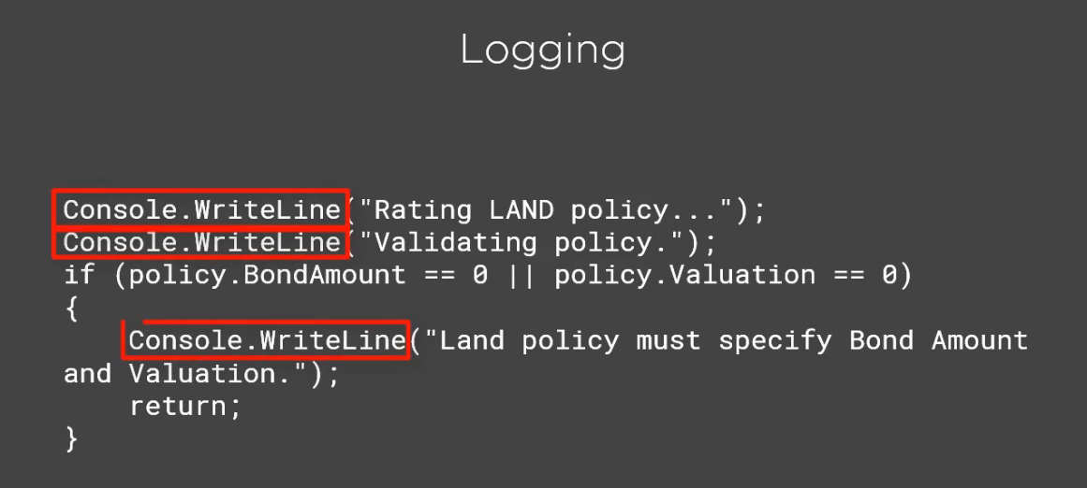
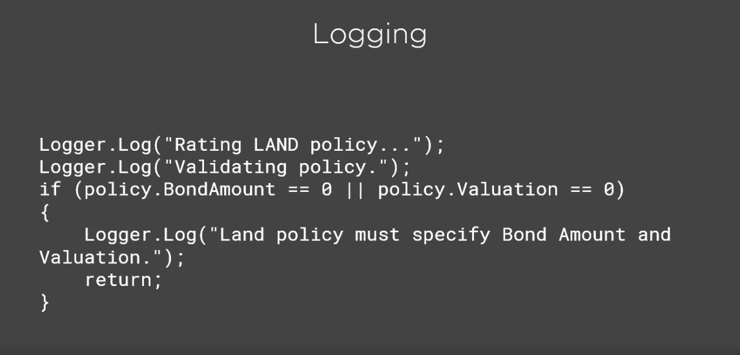

Slide 24
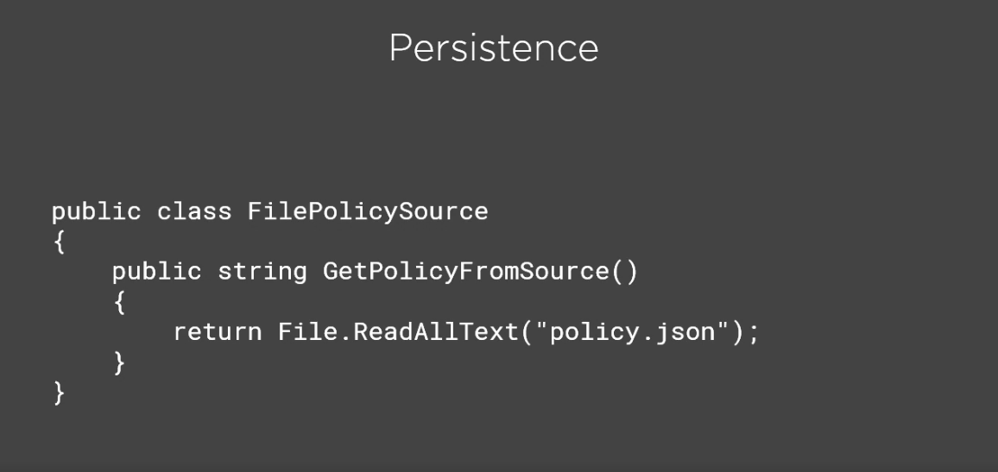
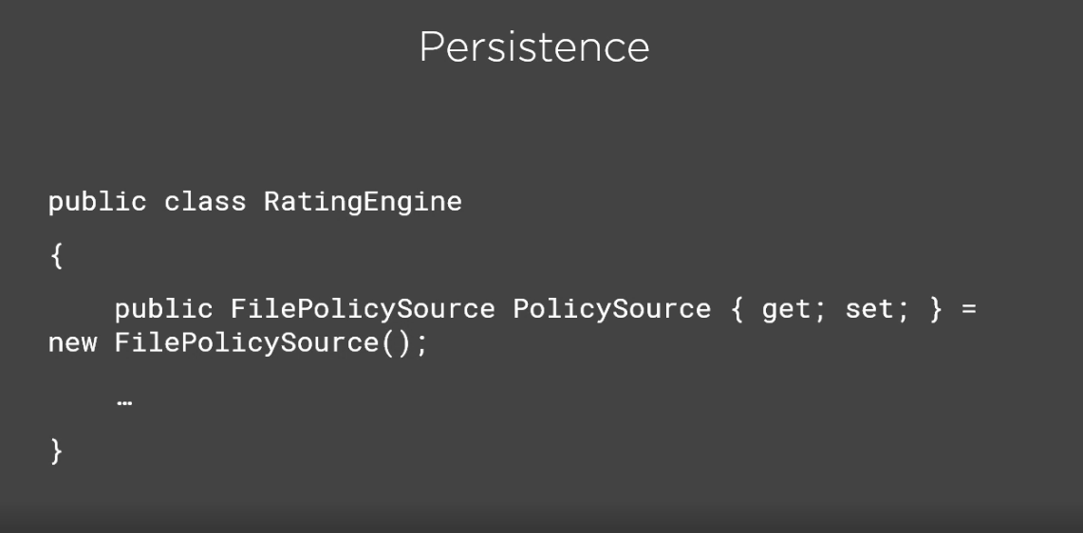

Slide 25
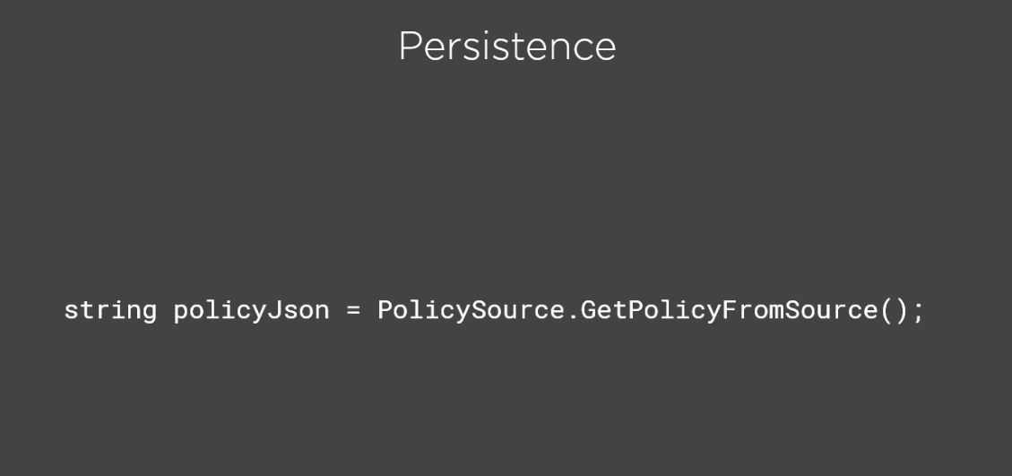
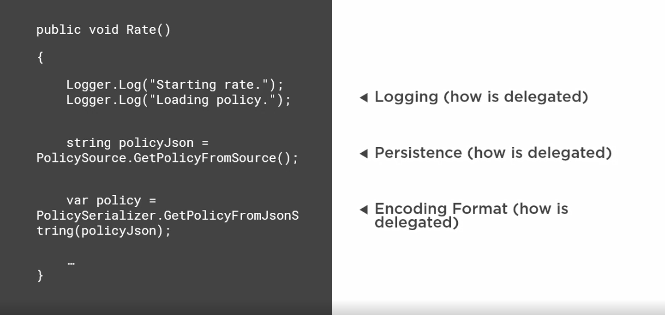

Slide 26
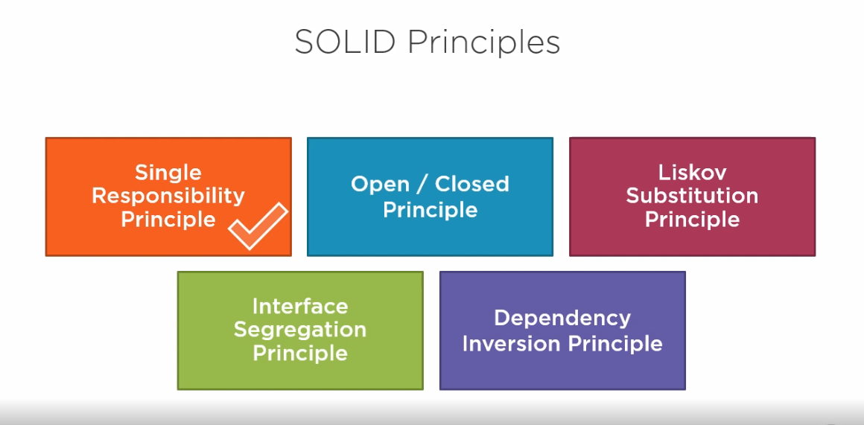
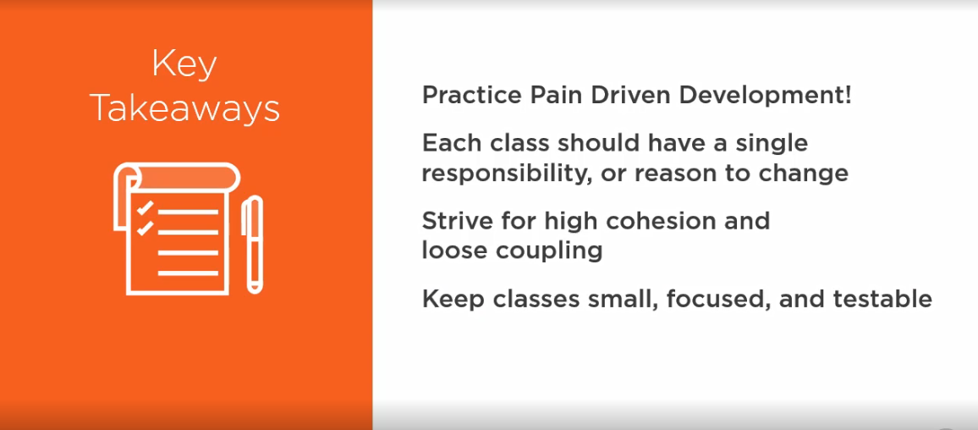
SRP

Slide 27
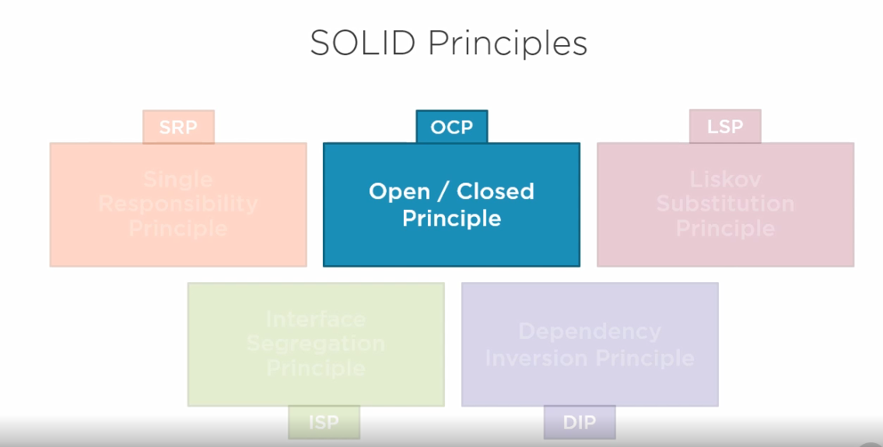
OCP

Slide 28
OPEN /Closed Principle
Software entities (Classes,modules,functions,etc) should be open for extension, but closed for modification.
Which means, any new functionality should be implemented by adding new classes, attributes and methods, instead of changing the current ones or existing ones.

Slide 29
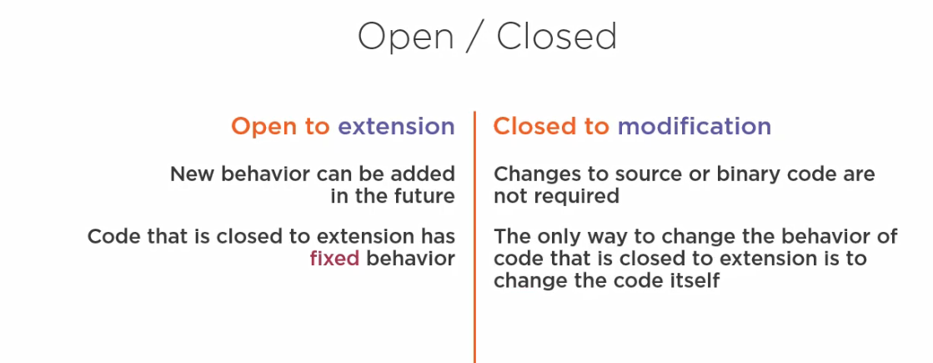

Slide 30
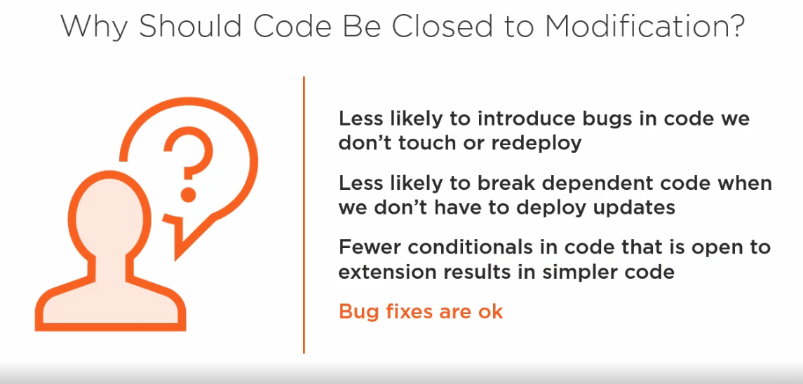

Slide 31
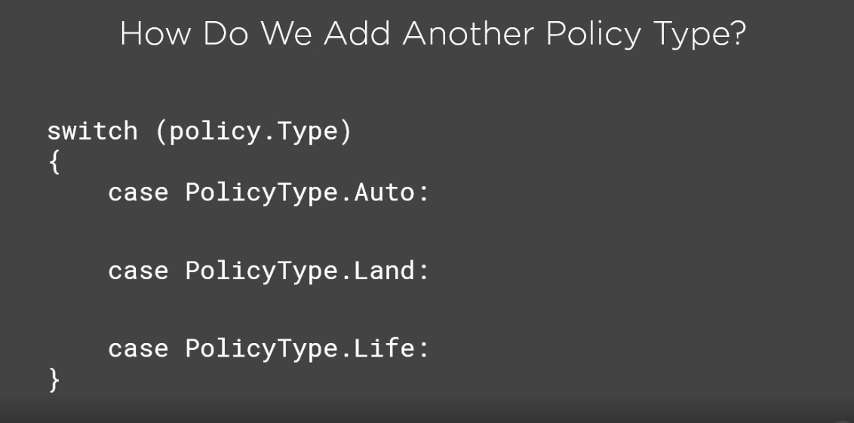

Slide 32
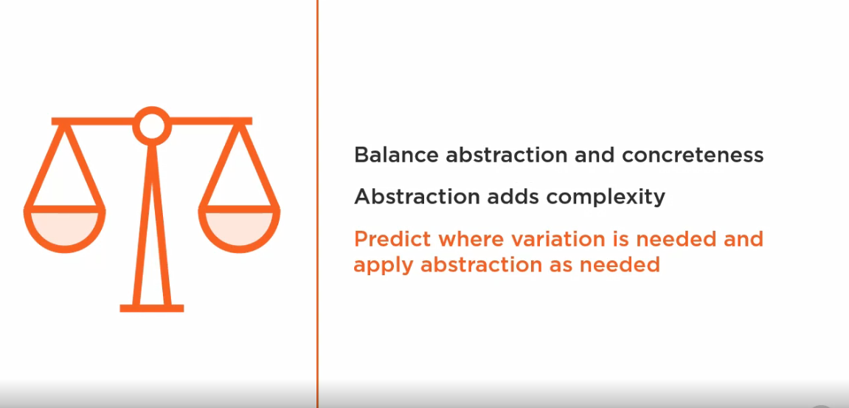

Slide 33
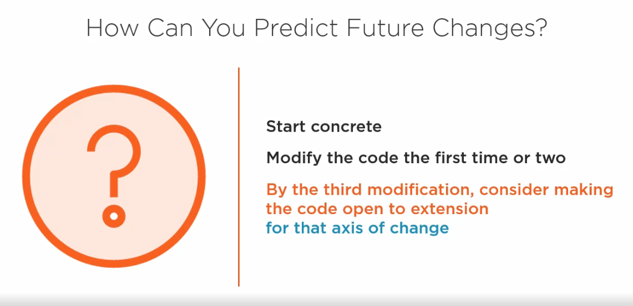

Slide 34
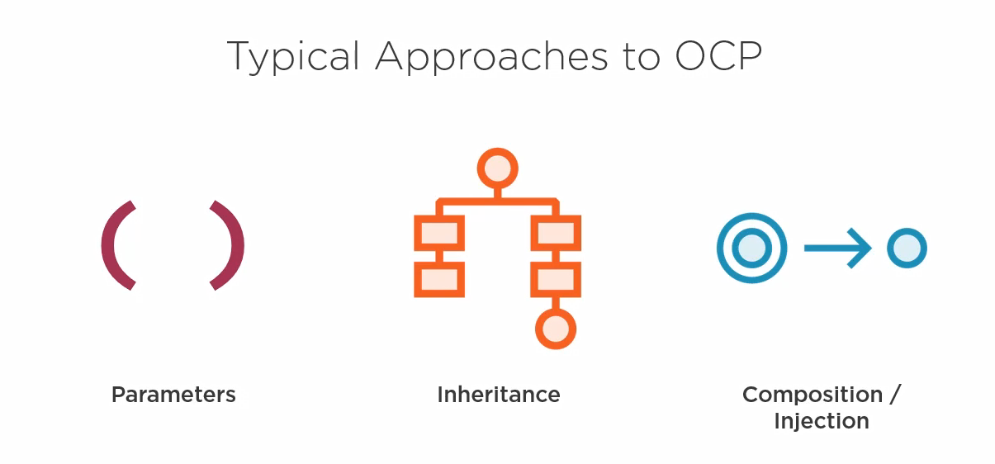

Slide 35
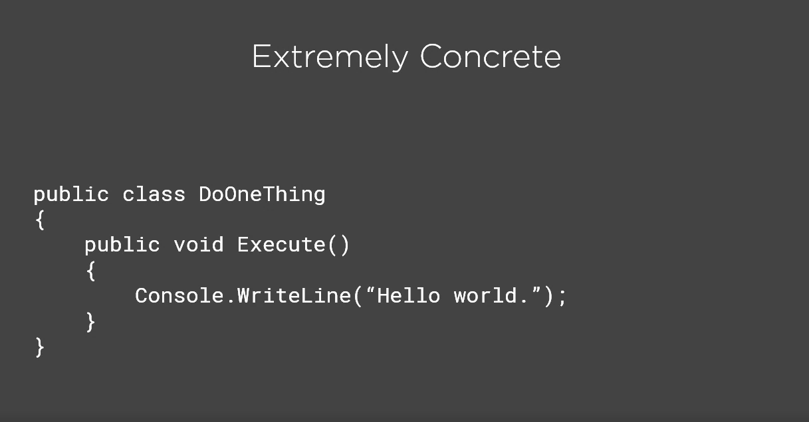
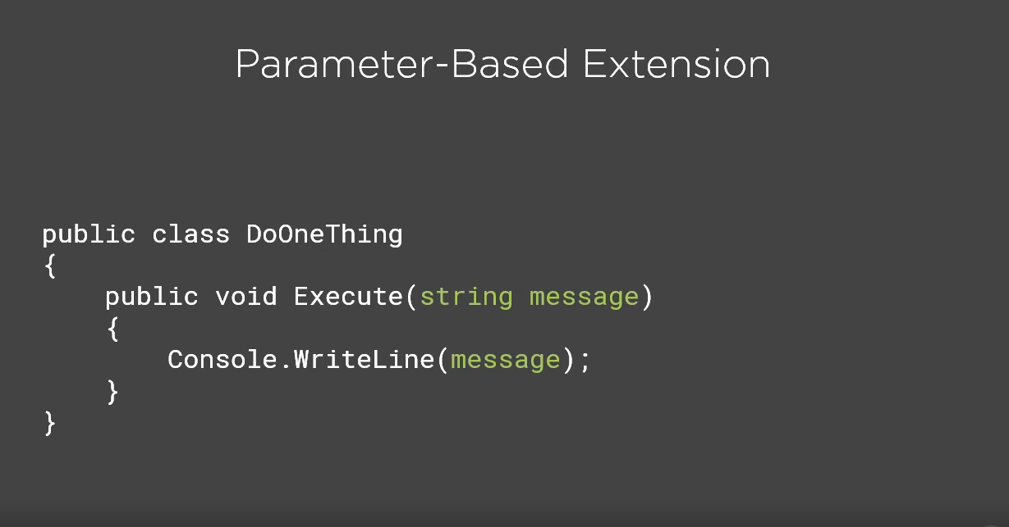

Slide 36
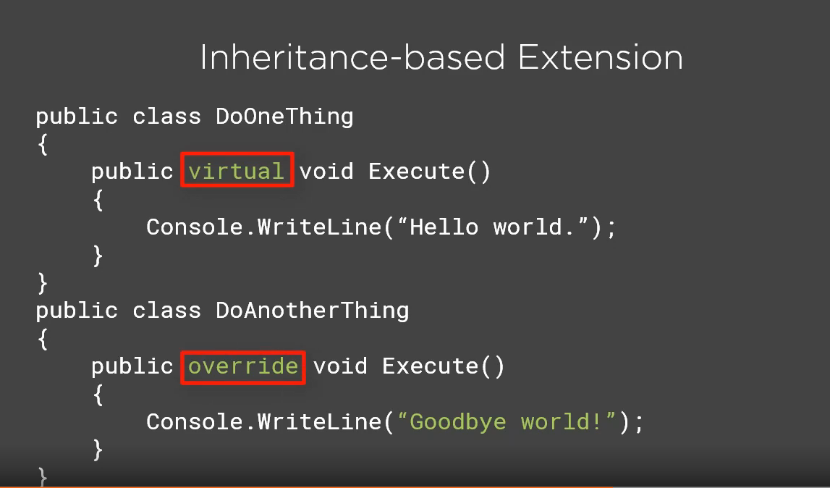
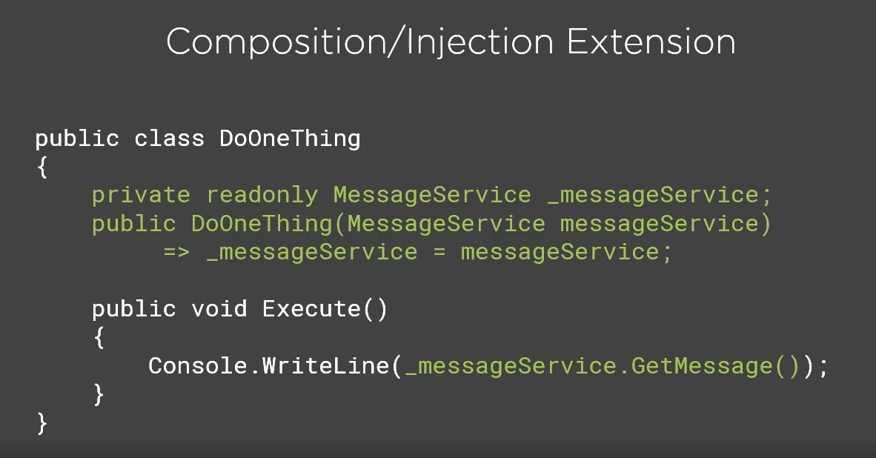

Slide 37


Slide 38
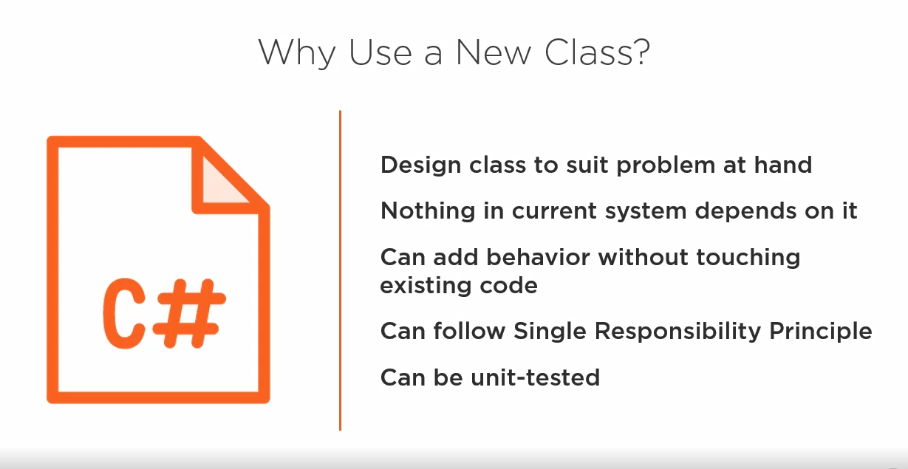

Slide 39
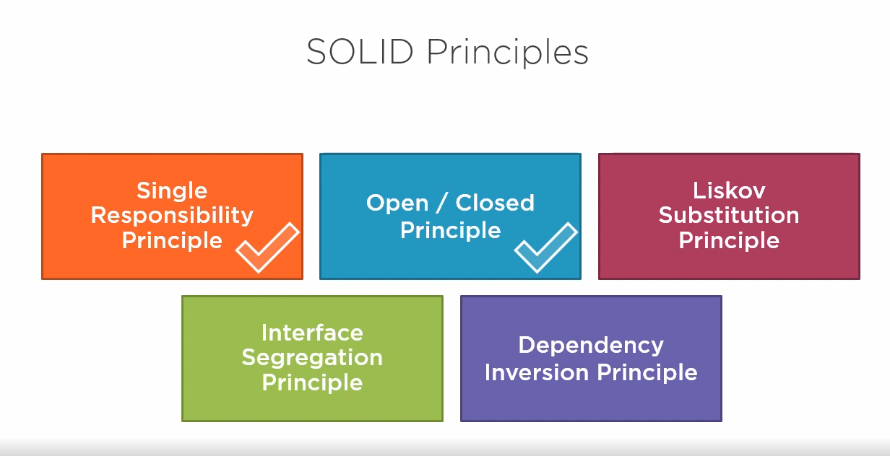
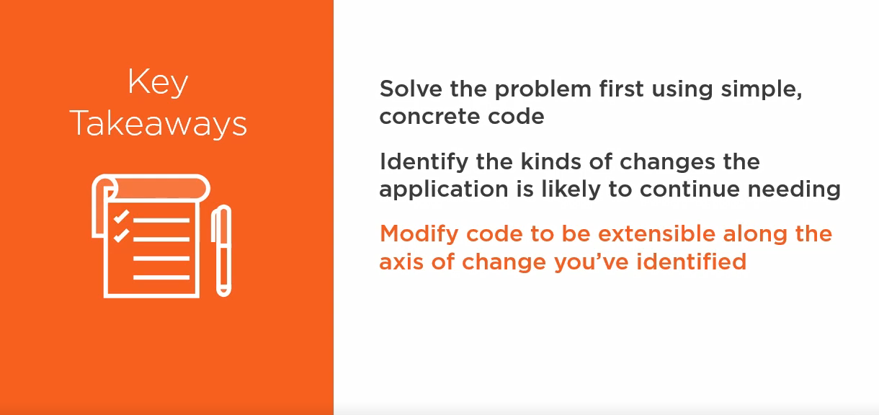
DEMO

Slide 40
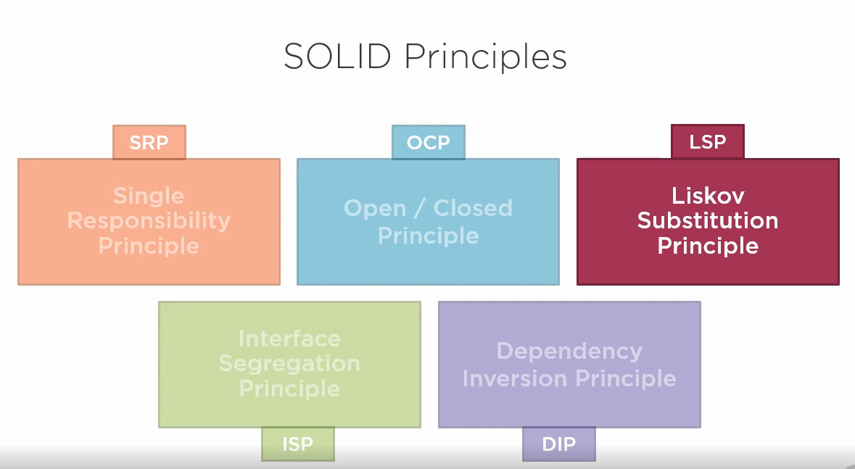
Liskov Substitution Principle

Slide 41
Liskov Substitution Principle
Let Φ(x) be a property provable about objects x of type T. Then Φ(y) should be true for objects y of type S where s is subtype of T.
Subtype must be substitutable for their base type.
Which means, Derived types must be completely substitutable for their base types
More formally, the Liskov substitution principle (LSP) is a particular definition of a subtyping relation, called (strong) behavioral subtyping

Slide 42
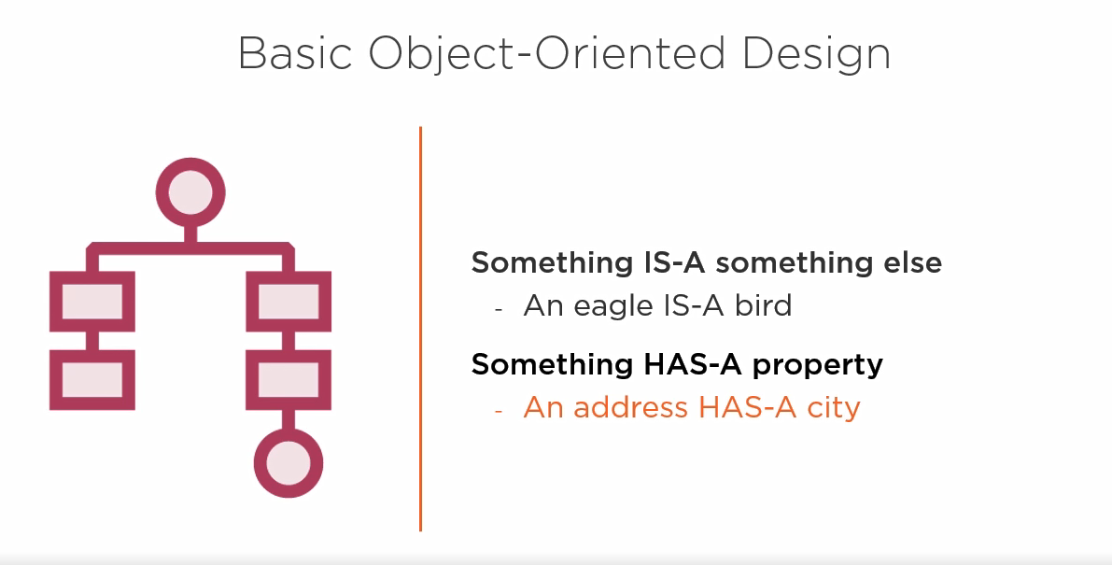
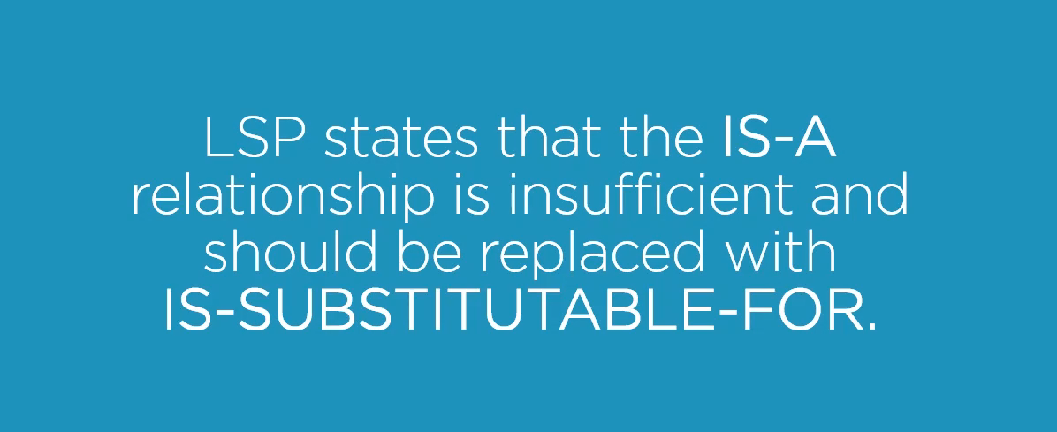

Slide 43
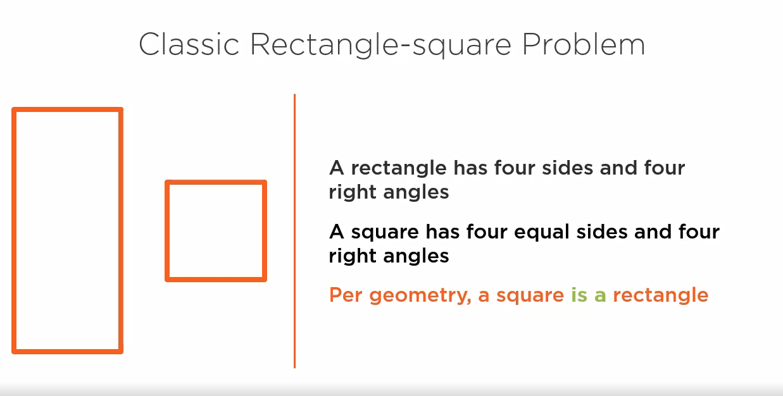

Slide 44
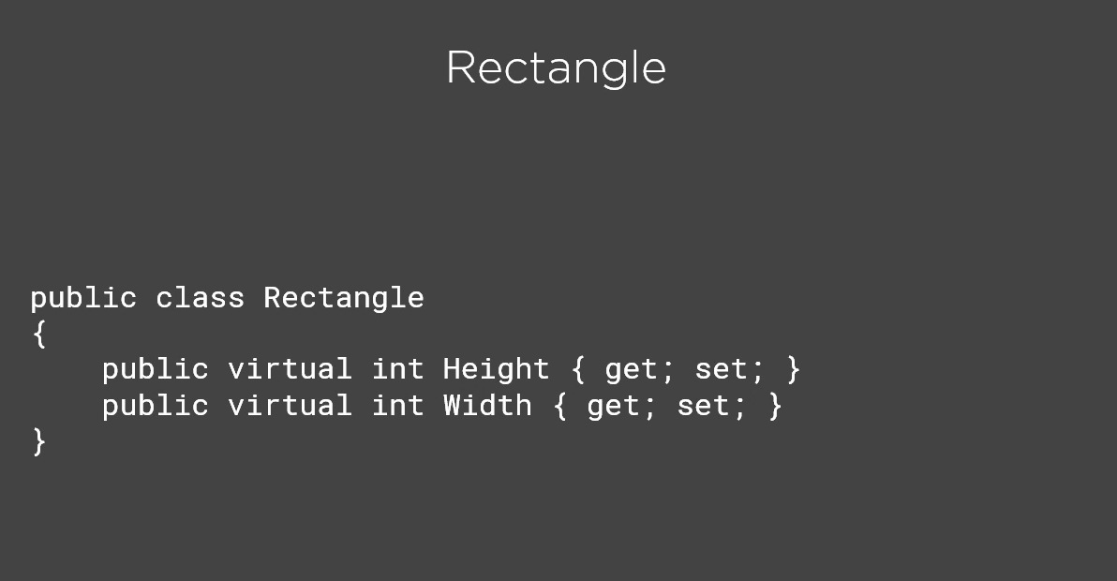
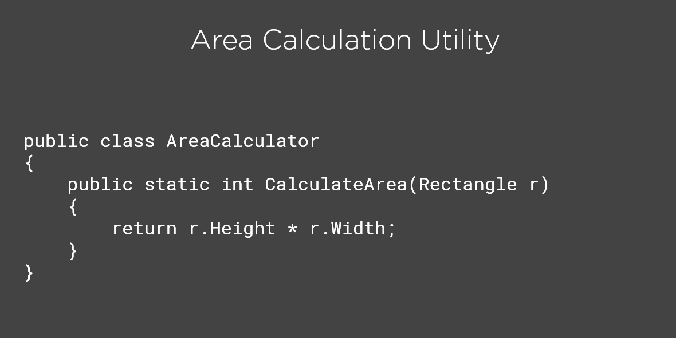

Slide 45



Slide 46


Slide 47



Slide 48


Slide 49



Slide 50


Slide 51



Slide 52



Slide 53



Slide 54

Interface Segregation Principle

Slide 55

ISP
Client should not be forced to depend on methods they do not use.
Prefer small, cohesive interfaces to large, “fat” ones.

Slide 56


Slide 57


Slide 58



Slide 59


Slide 60



Slide 61


Slide 62



Slide 63


Slide 64


Slide 65


Slide 66

Dependency Inversion Principle

Slide 67
DIP
High-level modules should not depend on low-level modules. Both should depend on abstractions.
Abstractions should not depend on details. Details should depend on abstractions.

Slide 68



Slide 69



Slide 70


Slide 71


Slide 72


Slide 73


Slide 74



Slide 75


Slide 76


Slide 77


Slide 78


Slide 79


Slide 80


Slide 81


Slide 82
?

